Slide 1
S1 Parental Workshop – Nov 2017 Show my Homework and Personal Support Time in S1
Mrs Forrester – S1 Year Head

Slide 2
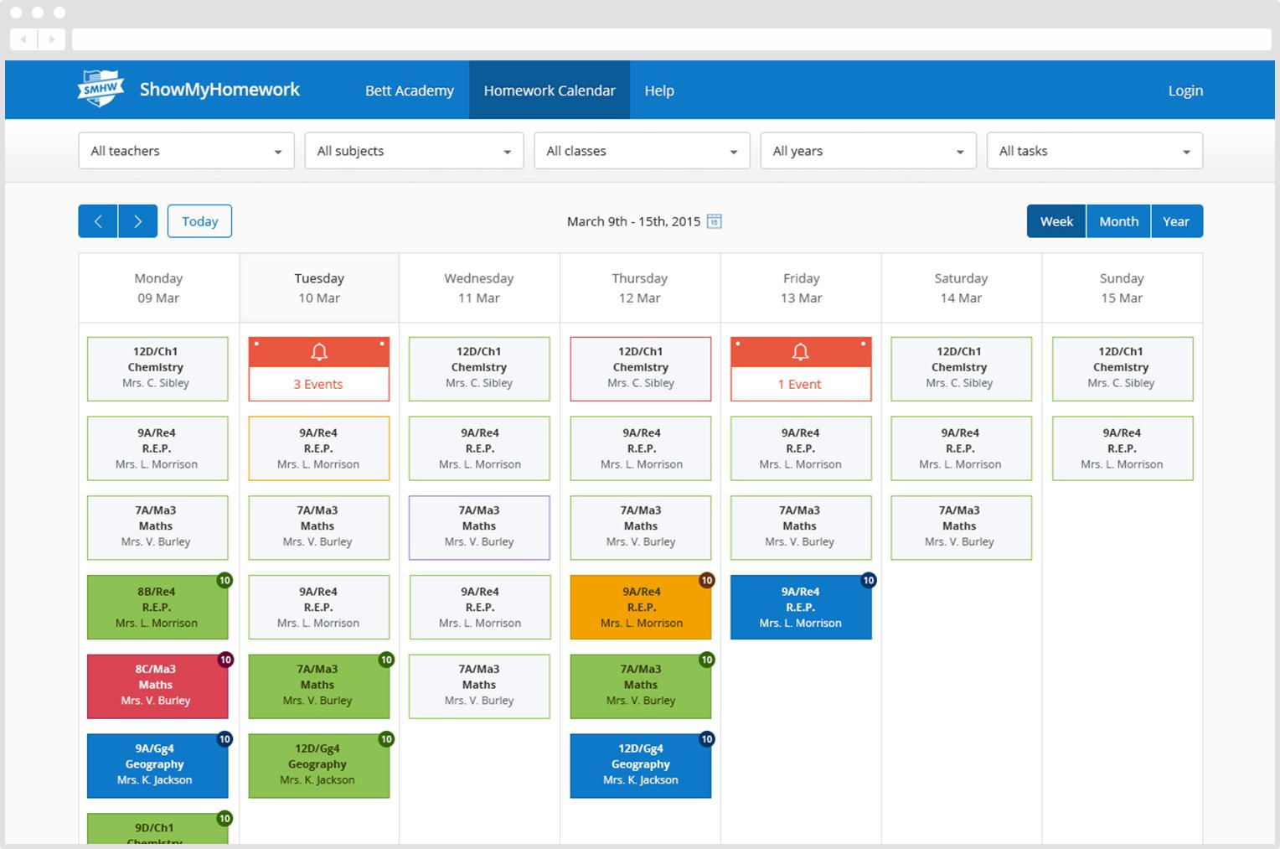
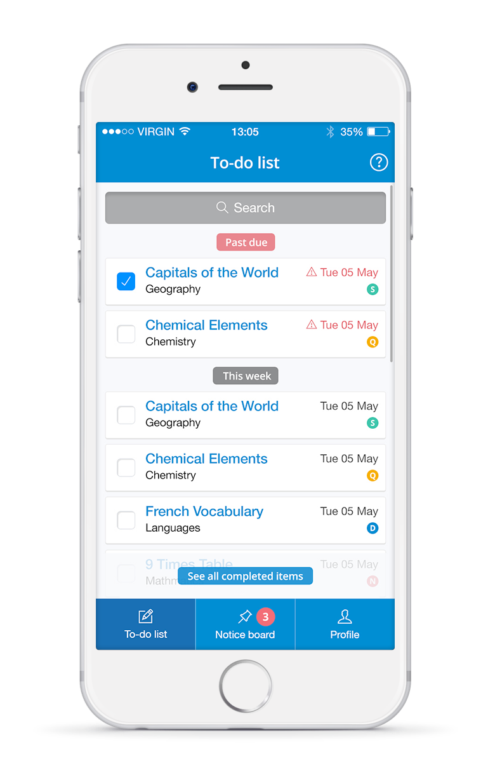
What is Show My Homework?
A simple online homework calendar showing homework information, deadlines and attachments for students.
Notes:
To change the image behind the Mock up.
Select the layer - > Right Click -> Send to Back -> Delete the image -> Drag & Drop your Own Picture -> Send to Back (again)

Slide 3
What is Show My Homework?
A simple online homework calendar showing homework information, deadlines and attachments for students.
If you download the parental app this is a sample of what you will see on your device:
Notes:
To change the image behind the Mock up.
Select the layer - > Right Click -> Send to Back -> Delete the image -> Drag & Drop your Own Picture -> Send to Back (again)

Slide 4
Benefits for parents
See how Show My Homework can benefit you
Communication
Accessibility
Visibility
Interaction
Better communication through school announcements.
Translation into 50+ languages.
You can see exactly how much homework has been set.
It’s much easier to take part in home learning.

Slide 5
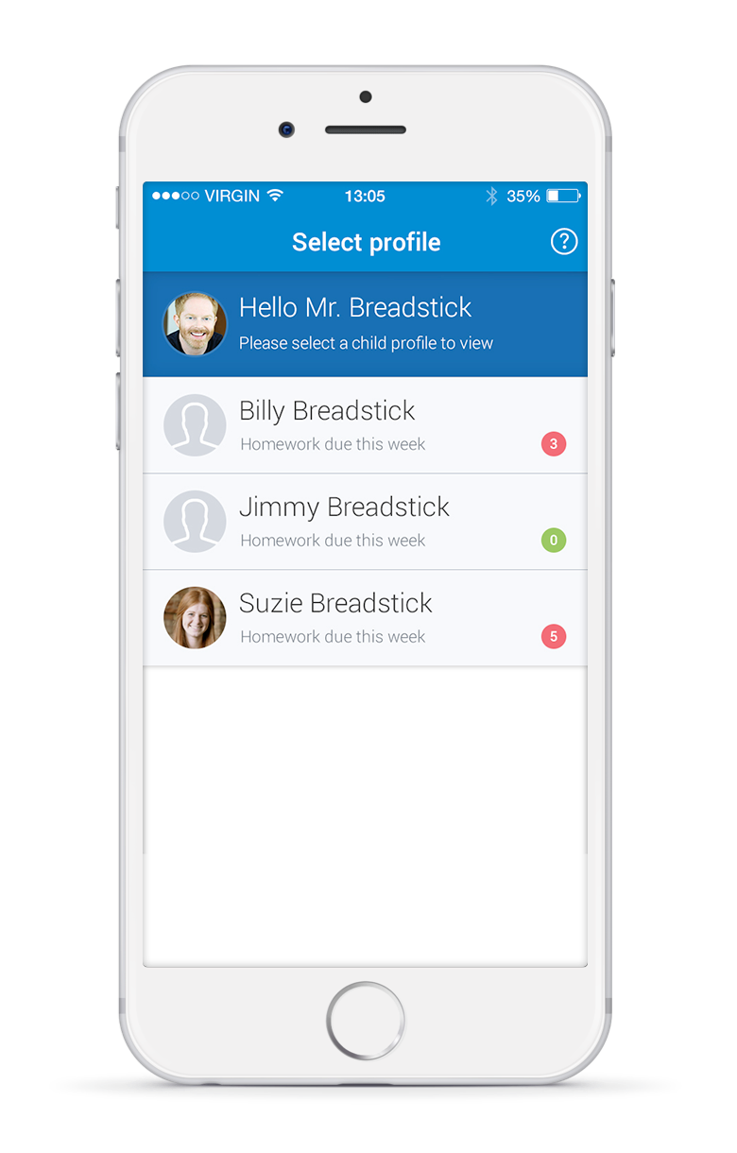
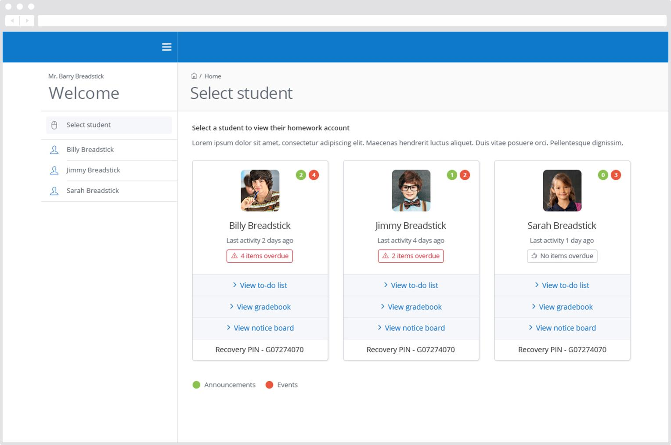
Multiple children
If you have more than one child at the school, they will appear on the same page.
Notes:
To change the image behind the Mock up.
Select the layer - > Right Click -> Send to Back -> Delete the image -> Drag & Drop your Own Picture -> Send to Back (again)

Slide 6
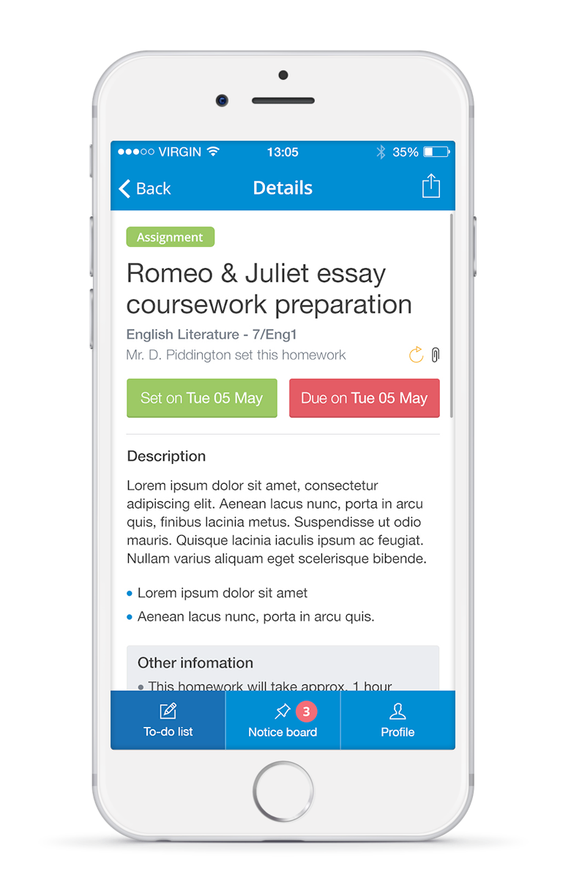
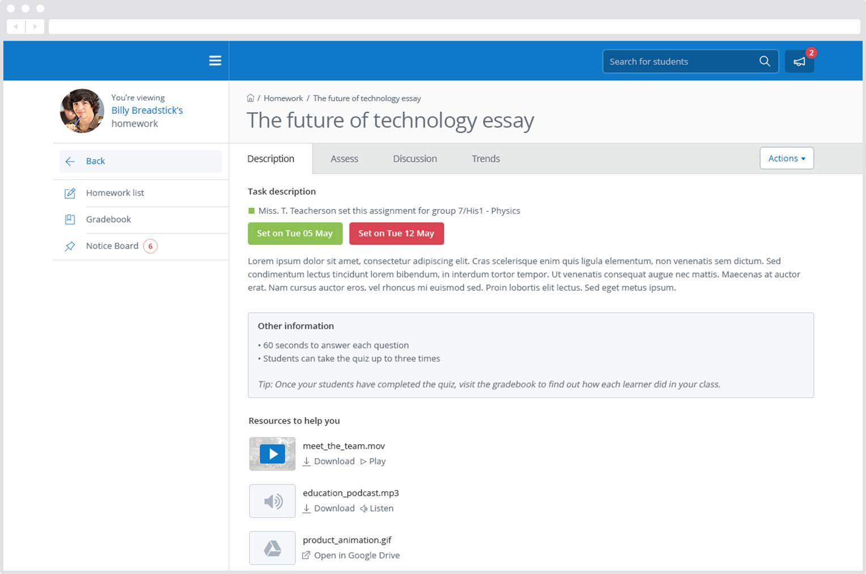
Homework description
In this view we can see a task’s title and description, set and due dates and how it should be submitted.
Notes:
To change the image behind the Mock up.
Select the layer - > Right Click -> Send to Back -> Delete the image -> Drag & Drop your Own Picture -> Send to Back (again)

Slide 7
Practical demonstration of homework here at Hyndland Secondary

Slide 8
If you have not been given a parental pin for Show my Homework please collect before you leave the workshop

Slide 9
Personal Support Time at Hyndland
Every student in S1-S6 spends 20 minutes per day in Personal Support Time.
This is a curricular area within the school.
In S1- S3 this involves a focus on developing literacy and numeracy skills as well as covering important areas of the health and well-being curriculum.

Slide 10
Why the focus on literacy & numeracy?
These are the foundations which allow learners to access the curriculum in both the broad general education but also as they prepare to undertake qualifications in the senior phase.
Students will also develop skills which are transferable in all subject areas e.g. research.
Allows tracking of progress and identification of students who require additional support.

Slide 11
What PST looks like in S1
30/10/17 – 24/11/17 | 27/11/17- 21/12/17 | 9/01/18- 10/02/18 | 13/02/18-17/03/18 | 20/03/18- 05/05/18 | 08/05/18- 09/06/18
Word classes – nouns, verbs, adjectives, adverbs & redundant adverbs | Numeracy ninjas – mental maths | Seen and heard (health and wellbeing) – UNICEF Child Poverty in the UK | Spelling strategies and Read-a-thon - Ties in with World Book Day | Numeracy ninjas – mental maths | Sentence types and sentence structure -

Slide 12
Exemplars of Materials
Please feel free to look at the exemplar material which will give you an insight into the Personal Support Time curriculum.
Information is also available on our school website under the curriculum section.

