Slide 1
Parents Presentation
Careers Adviser
Kate McMahon
Notes:
Advisers to add their name and date of presentation

Slide 2
Contents
Introduction to SDS
Career Management Skills
The changing youth labour market
My World of Work
Helping you to help your child

Slide 3
Skills Development Scotland (SDS)
SDS is the national skills body supporting people and businesses to develop and apply their skills
We work in partnership to enable people to reach their potential and make skills work for employers
We will support people to develop effective career management skills
Developing effective career management skills will enable people to make informed career choices throughout their life
Notes:
Introduce the work of SDS
Advisers can personalise the delivery with details of the partnership working in their school

Slide 4
My role in school
1 – 1 Careers Interviews with pupils.
Ongoing coaching support to help pupils develop their Career Management Skills (help them to make the right career decision) – 1-1 support now starts in S2.
Provide advice and information on the range of post school options – college/university/modern apprenticeship/employment/training.
Targeting pupils for Careers Events eg Construction Skills, BAE, Medical Applications
Supporting pupils at college application sessions (throughout January/February)
Careers Lessons – group work for S1 up to S6
Promoting opportunities (Foundation Apprenticeships/Modern Apprenticeships/Jobs)
Drop in service at lunchtimes
Strong partnership working with DHT’s, Pastoral Care, ESP Co ordinator to support the achievement of positive destinations for pupils
Notes:
Introduce the work of SDS
Advisers can personalise the delivery with details of the partnership working in their school

Slide 5
Where school leavers go next...
18%
11%
0.5%
Source: National School Leaver Destinations (Initial Destinations), 2013-14 Skills Development Scotland
Source: National School Leaver Destinations (Initial Destinations), 20123-14 Skills Development Scotland
Notes:
To make this slide more interactive either get young people to shout out possible destinations such as HE/FE etc. or guess which destinations were most popular.
Scotland HE 38, FRE 28, Training 4, Emp 21, vol 0.5, u/e seek 6%, Ac ag 1%, U/E not seek 1%, uk 0.5%
Note: Modern Apprenticeship figure is included within Employment figure.HE 58%, FE 18%, NTP 5%, other tr 2%, Em 11%, Vol %m PSD 0.5%, U/E 4%, U/E NS 1% Uk 0.5%

Slide 6
Career Management Skills
Self: knowing who you are
Strengths: knowing what you are good at
Horizons: knowing what’s out there
Networks: knowing who can help you
Notes:
This slide sets out the Framework within which we are developing CMS grouped into four themes of Self, Strengths, Horizons and Networks. These skills help individuals to make effective decisions and realise their potential at any point in their life.

Slide 7
The changing youth labour market
The youth labour market has changed over the last 30 – 40 years
There are fewer entry level jobs for young people and more competition for them
Nearly two thirds of young people now go on to college or university before going into work
The average person has 10 – 15 jobs in their life time
80% of jobs are not advertised
This means young people have to be well prepared for the world of work
Notes:
Here are some interesting points which highlight the changes on the youth labour market in the last 30 – 40 years.
You can add your own example of interesting and / or local information

Slide 8
My World of Work
My World of Work is Scotland’s careers information and advice web service
It can support you as a parent / carer as well as your child
Your child will be introduced to My World of Work and supported to set up their individual account. This gives them access to a wealth of career information and resources
Notes:
Describe the benefits of registering on the site and having an individual account. Parents can have their own account on My WoW

Slide 9
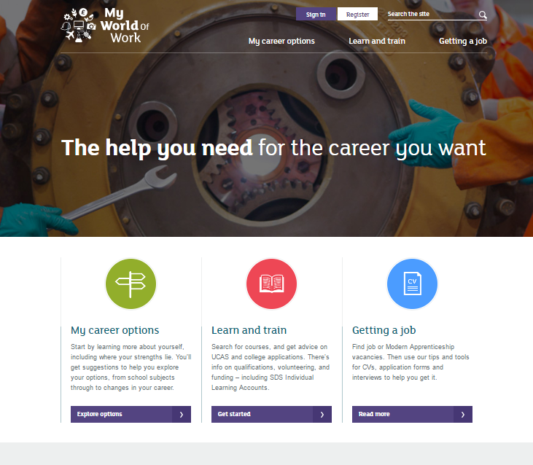
Videos
Articles
Networking
Social Media
Notes:
Highlight that SDS is part of their network including My World of Work which can provide tools to help inform and inspire their career development
Raise awareness of social networking sites such as Twitter and Facebook where SDS has a presence and introduce the concept that they can use these for their own networking.
For example young people can use social networking sites to:
search for jobs / volunteering / work experience
let employers know they are looking for one or all of these
make connections with employers or other people in the industry they are interested in
market themselves by uploading their CV
Ensure the group realise social media is being increasingly used by employers to advertise vacancies and to search for employees in a recent recruiting suvery 92% of employers now use social media as a hiring tool e.g.; 87% LinkedIn; 55% Facebook; 47% Twitter
many, qualifications, are they well-rounded, and check for any warning signs. Source: Recruiter Nation Survey 2015

Slide 10
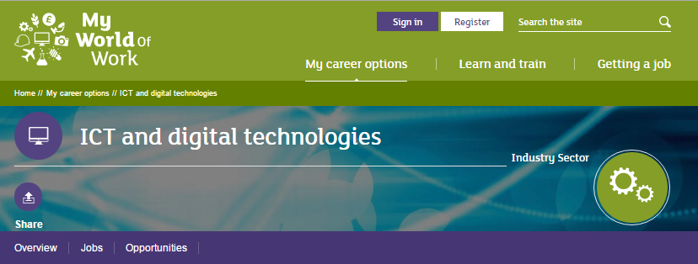
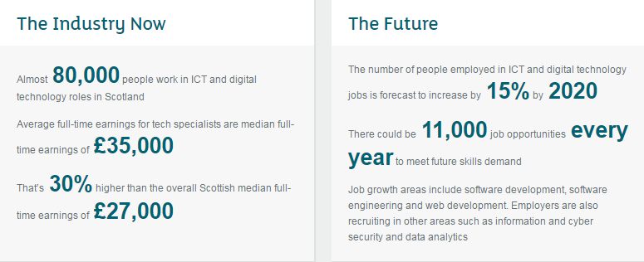
Meet the industries
Notes:
The industry sectors pages within My World of Work will give you current and up to date information on key sectors in Scotland now and in the future
Links to sections within My World of Work: https://www.myworldofwork.co.uk/search/sitewide/future%20jobs?group=industry_page#search-results
Note - Link via Regional Skills Assessment for local authority level information on Sectoral outlook and Industrial Structure

Slide 11
Helping you to help your child
Online:
myworldofwork.co.uk/parents
Online support – web chat with an adviser
Telephone:
you can speak to an adviser on 0800 917 8000

Slide 12
You can follow us on:
@mywowscotland
My World of Work
My World of Work
Notes:
Conclude presentation by highlighting SDS’s presence on Facebook, Twitter and You Tube
By following SDS on social media sites parents can keep up to date with information, events and key application dates

