Slide 1
iPad Accessibility Features to support your learning
Where to find them and how to use them.

Slide 2
Introduction
This short guide will take you through some of the features available on the iPad and Microsoft Office that you can use to help support your learning.
There is also a short video showing where to find these features included in your digital pack.
If you have any questions or concerns, please contact the Support for Learning team.

Slide 3
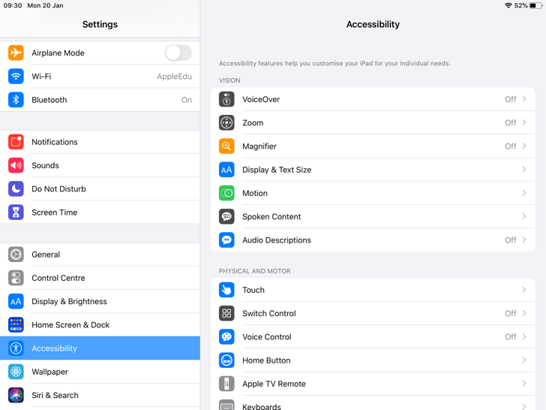


iPad Accessibility Menu
The main menu for the Accessibility features are found by going to the Settings app
Scroll down on the left hand side until you see the Accessibility menu

Slide 4
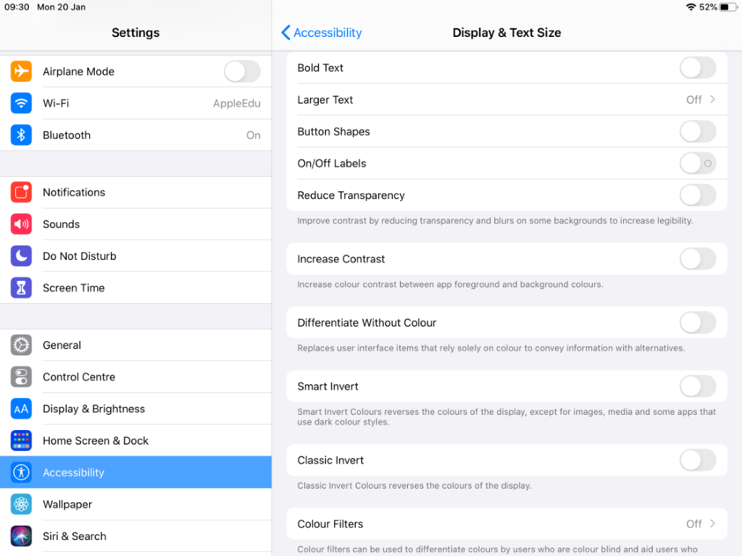
Display and Text Size
Adjusts the text to suit your needs. Can increase or reduce the size or make the text bold to increase contrast.
Colour Filters- replicates the use of a coloured overlay. Select the colour (hue) of your overlay and the intensity (strength) you need.

Slide 5
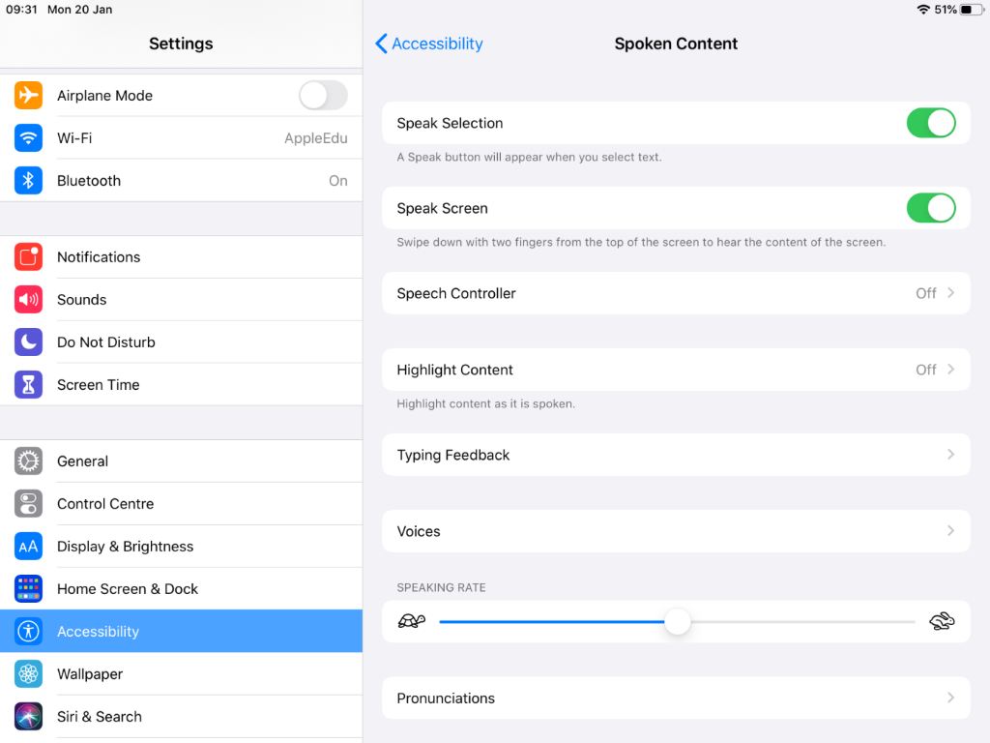
Spoken content
The iPad acts as a reader for you. You must bring headphones to use this function in class.
Turn on Speak Selection and Speak Screen.
Highlight Content- set up to have the word or sentence being read highlighted.
Typing Feedback: Useful option to activate is Hold to Speak Predictions. Reads out predicted words when typing.
Voices: Select the voice you find most pleasant to listen to from the UK voice choices. Adjust the speaking rate to suit your requirements.

Slide 6
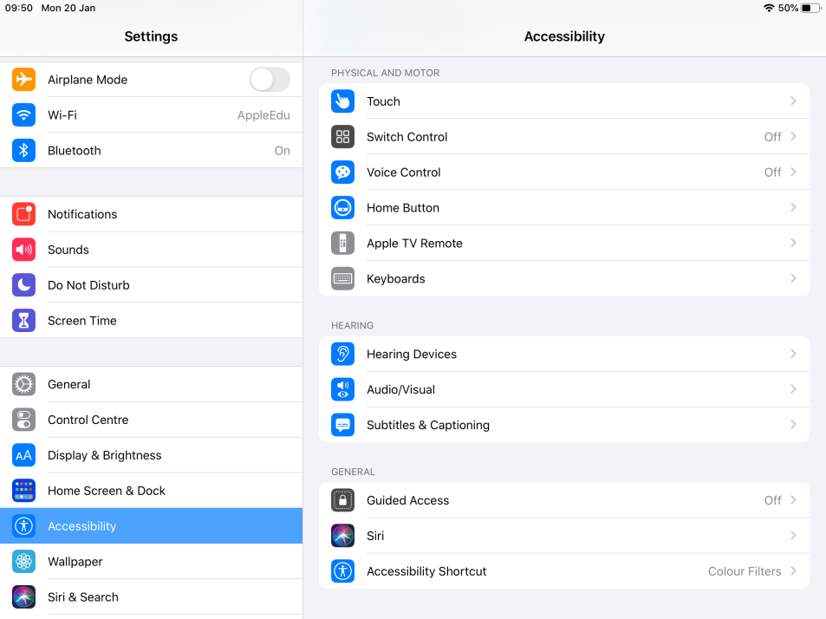
Accessibility Shortcut
Located at the bottom of the general accessibility menu.
Handy to set up if you use a colour tint.
Choose options to engage when you press the home button 3 times quickly.

Slide 7

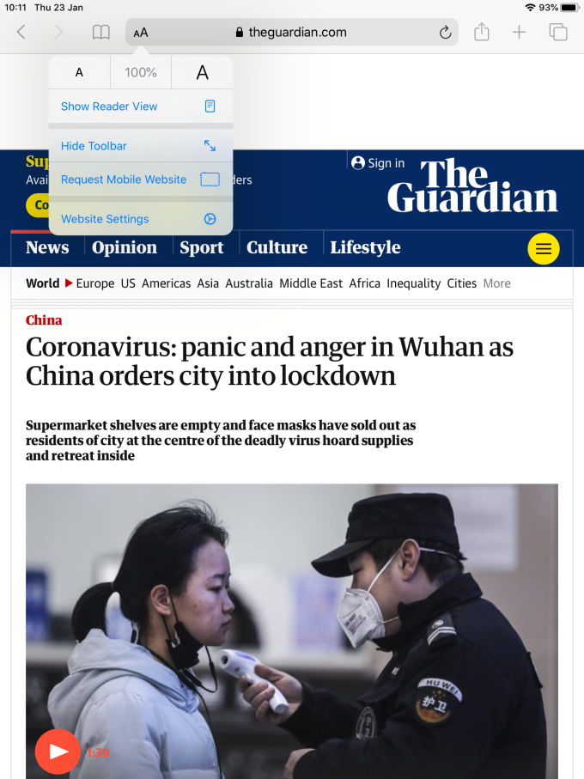
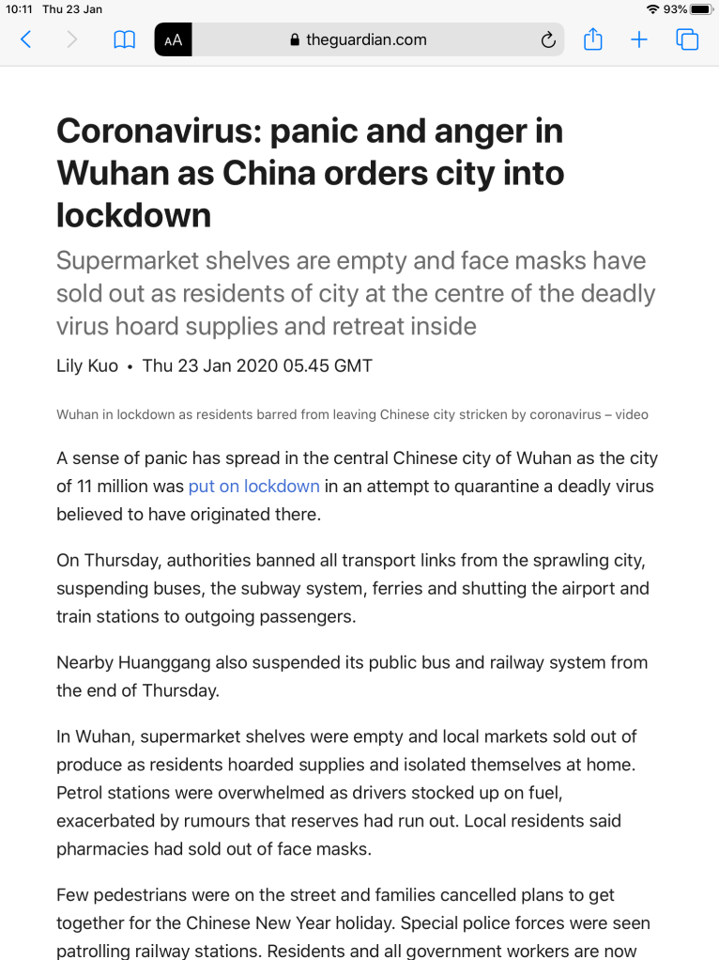
Safari Reader Mode
Simplifies webpages and removes distracting content such as adverts, banners and links.
Access by pressing the AA at the side of the address bar and selecting Show Reader View.
On the left is the original webpage, on the right is the Reader View.

Slide 8
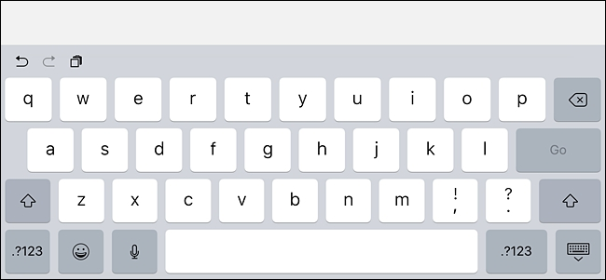
Dictation
Accessed via onscreen keyboard by pressing the microphone icon.
If asked, press enable dictation.
Speak into the microphone, does not have to be loud, and it will type your words.
You must speak to add punctuation e.g. say "full stop" to add a .

Slide 9
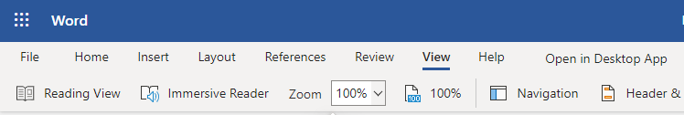
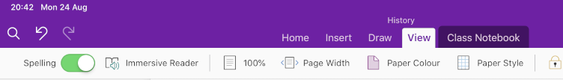
Microsoft 365 Support Functions: Immersive Reader
Available on the VIEW tab of Word and OneNote.
Alternative to iPad Spoken Content.
Can increase spacing between words, identify word types, split syllables as well as reading aloud.

Slide 10
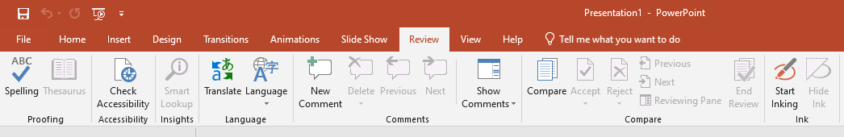
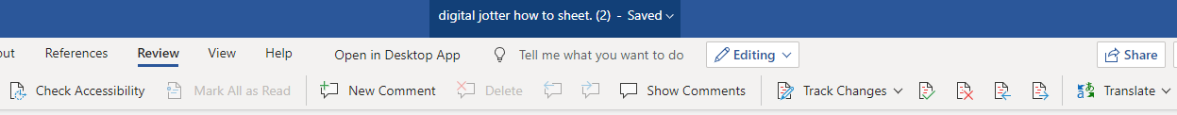

Microsoft 365 Support Functions: Translation Tool
Available through the desktop and web based versions of Word, OneNote and desktop version of PowerPoint but not the iPad apps.
Located in the REVIEW tab
Can translate single key words into your selected language.

Slide 11
Microsoft 365 Support Functions: OneNote
Lots of features available via OneNote if you use this as a digital jotter.
Please see the accompanying document and video about setting this up.

